Slide 1
JavaScript
(30 hours)
Notes:
Title - The learning outcome
Subtitle - Duration

Slide 2
In this section, we will discuss:
Introduction to JavaScript
Javascript Datatype
Javascript Condition
JavaScript Array
JavaScript Function
Notes:
Mention the parent topics one by one. This particular learning outcome has 4 parent topics.

Slide 3
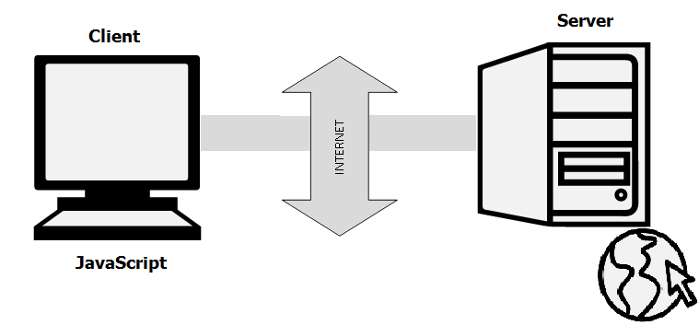
Introduction to JavaScript
What is JavaScript
JavaScript is a very powerful client-side scripting language.
JavaScript is used mainly for enhancing the interaction of a user with the webpage.
Image Source: https://www.guru99.com/images/JavaScript/javascript1_1.png
Notes:
Left (White Color space):
Title - Parent Topic
Subtitle - Subtopic 1
Body Text - Description in bullets
Right (Grey Color Space):
Body Text - Relevant image (with source)/code snippet
Put reference links in Speaker Notes
Reference:
https://www.tutorialspoint.com/internet_technologies/internet_overview.htm/

Slide 4
Introduction to JavaScript
Why JavaScript
JavaScript offers lots of flexibility.
Mobile app development, desktop app development, and game development.
With javascript you can find tons of frameworks and libraries already developed, which can be used directly in web development.
Image Source: https://www.guru99.com/images/JavaScript/javascript1_1.png
Notes:
Left (White Color space):
Title - Parent Topic
Subtitle - Subtopic 1
Body Text - Description in bullets
Right (Grey Color Space):
Body Text - Relevant image (with source)/code snippet
Put reference links in Speaker Notes
Reference:
https://www.tutorialspoint.com/internet_technologies/internet_overview.htm/

Slide 5

Introduction to JavaScript
What is JavaScript Used For
JavaScript is used in various fields from the web to servers:
Web Applications
Mobile Applications
Web-based Games
Back-end Web Development
Image Source: https://www.simplilearn.com/ice9/free_resources_article_thumb/js-app.JPG
Notes:
Left (White Color space):
Title - Parent Topic
Subtitle - Subtopic 1
Body Text - Description in bullets
Right (Grey Color Space):
Body Text - Relevant image (with source)/code snippet
Put reference links in Speaker Notes
Reference:
https://www.tutorialspoint.com/internet_technologies/internet_overview.htm/

Slide 6
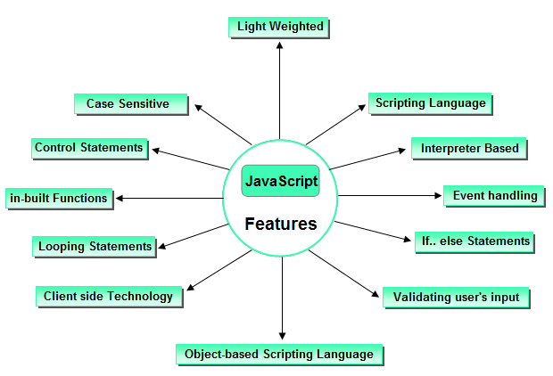
Introduction to JavaScript
Features of JavaScript
There are various features of javascript:
Image Source: https://tuannguyen.tech/wp-content/uploads/2019/08/javascript-features.png
Notes:
Left (White Color space):
Title - Parent Topic
Subtitle - Subtopic 1
Body Text - Description in bullets
Right (Grey Color Space):
Body Text - Relevant image (with source)/code snippet
Put reference links in Speaker Notes
Reference:
https://www.tutorialspoint.com/internet_technologies/internet_overview.htm/

Slide 7
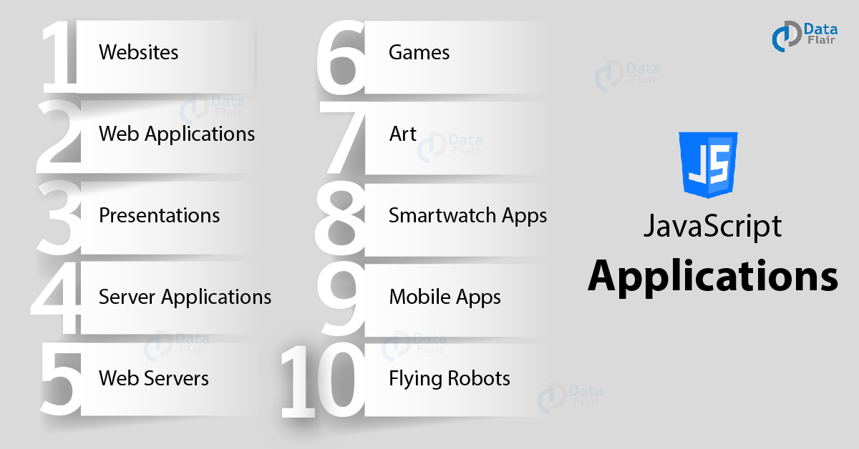
Introduction to JavaScript
Application of JavaScript
JavaScript is used to create interactive websites. It is mainly used for:
Client-side validation,
Dynamic drop-down menus,
Displaying date and time,
Displaying pop-up windows and dialog boxes.
Displaying clocks etc.
Image Source: https://data-flair.training/blogs/wp-content/uploads/sites/2/2019/02/JavaScript-Applications.jpg
Notes:
Left (White Color space):
Title - Parent Topic
Subtitle - Subtopic 1
Body Text - Description in bullets
Right (Grey Color Space):
Body Text - Relevant image (with source)/code snippet
Put reference links in Speaker Notes
Reference:
https://www.tutorialspoint.com/internet_technologies/internet_overview.htm/

Slide 8
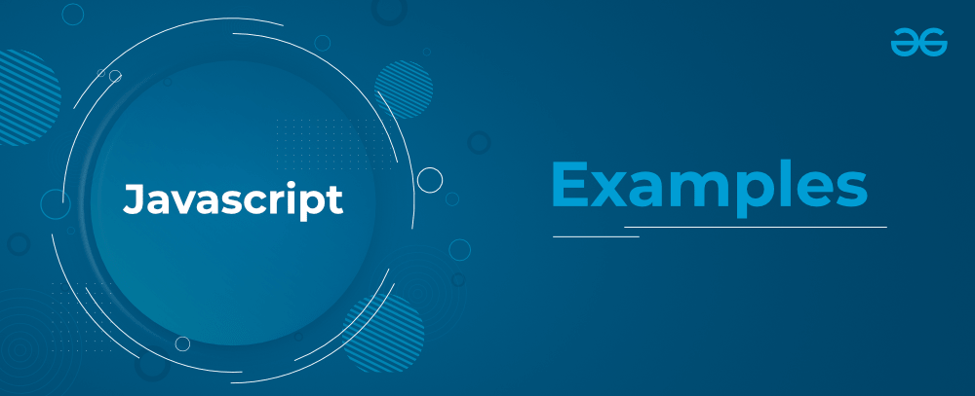
Introduction to JavaScript
JavaScript Example
<script type="text/javascript">
document.write("JavaScript is a simple language for javatpoint learners");
</script>
JavaScript provides 3 places to put the JavaScript code:
within body tag,
within head tag and
external JavaScript file.
Image Source: https://media.geeksforgeeks.org/wp-content/cdn-uploads/20211001052647/JavaScriptEx-min.png
Notes:
Left (White Color space):
Title - Parent Topic
Subtitle - Subtopic 1
Body Text - Description in bullets
Right (Grey Color Space):
Body Text - Relevant image (with source)/code snippet
Put reference links in Speaker Notes
Reference:
https://www.tutorialspoint.com/internet_technologies/internet_overview.htm/

Slide 9
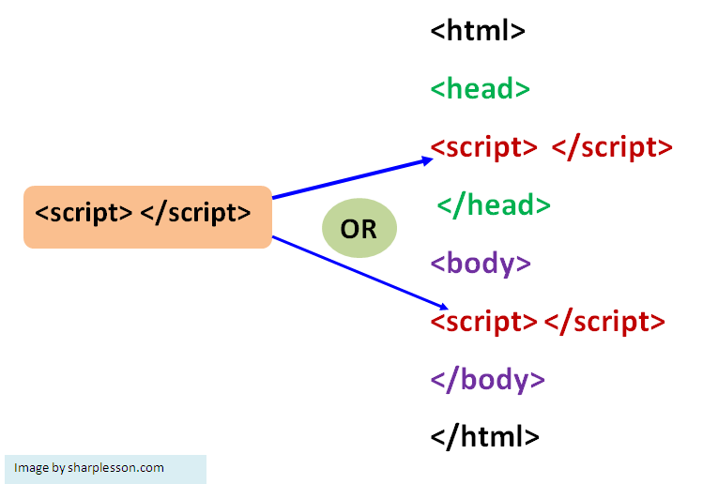
Introduction to JavaScript
JavaScript Syntax
JavaScript provides 3 places to put the JavaScript code:
within body tag,
within head tag and
external JavaScript file.
Image Source: https://sharplesson.com/wp-content/uploads/2019/10/javascript-syntax.png
Notes:
Left (White Color space):
Title - Parent Topic
Subtitle - Subtopic 1
Body Text - Description in bullets
Right (Grey Color Space):
Body Text - Relevant image (with source)/code snippet
Put reference links in Speaker Notes
Reference:
https://www.tutorialspoint.com/internet_technologies/internet_overview.htm/

Slide 10
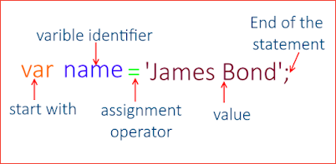
JavaScript Variables
What is Variable?
Variables are used to store data, like string of text, numbers, etc. The data or value stored in the variables can be set, updated, and retrieved whenever needed.
Example:
var name = "Peter Parker";
var age = 21;
var isMarried = false;
Image Source: https://lh3.googleusercontent.com/-YXC3gtpMlko/X3HA5DHH6MI/AAAAAAAAB3Q/VYM81zAFldY-cItuj7GMYA0Xy7Fy0GWBgCLcBGAsYHQ/image.png
Notes:
Left (White Color space):
Title - Parent Topic
Subtitle - Subtopic 1
Body Text - Description in bullets
Right (Grey Color Space):
Body Text - Relevant image (with source)/code snippet
Put reference links in Speaker Notes
Reference:
https://www.tutorialspoint.com/internet_technologies/internet_overview.htm/

Slide 11
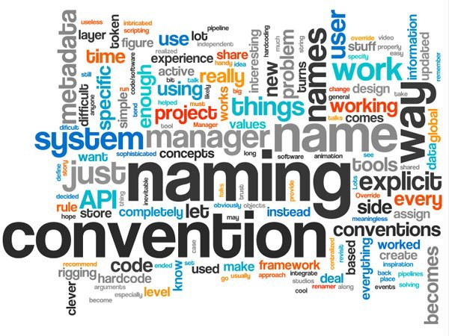
JavaScript Variables
Declaring Multiple Variables at Once
These are the following rules for naming a JavaScript variable:
A variable name must start with a letter, underscore (_), or dollar sign ($).
A variable name cannot start with a number.
Image Source: https://miro.medium.com/max/600/1*o960btjPmdMY5468NIcaGA.jpeg
Notes:
Left (White Color space):
Title - Parent Topic
Subtitle - Subtopic 1
Body Text - Description in bullets
Right (Grey Color Space):
Body Text - Relevant image (with source)/code snippet
Put reference links in Speaker Notes
Reference:
https://www.tutorialspoint.com/internet_technologies/internet_overview.htm/

Slide 12
JavaScript Variables
Declaring Multiple Variables at Once
A variable name can only contain alpha-numeric characters (A-z, 0-9) and underscores.
A variable name cannot contain spaces.
A variable name cannot be a JavaScript keyword or a JavaScript reserved word.
Image Source: https://miro.medium.com/max/600/1*o960btjPmdMY5468NIcaGA.jpeg
Notes:
Left (White Color space):
Title - Parent Topic
Subtitle - Subtopic 1
Body Text - Description in bullets
Right (Grey Color Space):
Body Text - Relevant image (with source)/code snippet
Put reference links in Speaker Notes
Reference:
https://www.tutorialspoint.com/internet_technologies/internet_overview.htm/

Slide 13
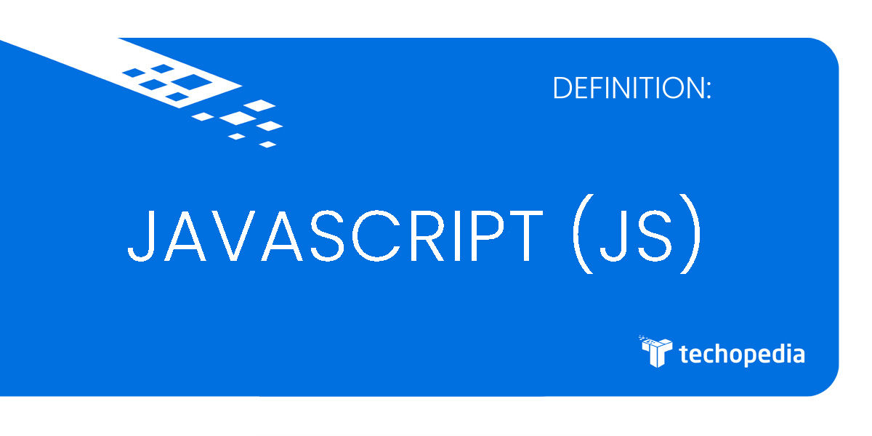
Javascript Datatype
Definition
JavaScript is dynamic and loosely typed language. It means you don't require to specify a type of a variable. A variable in JavaScript can be assigned any type of value, as shown in the following
Image Source: https://images.techopedia.com/definition/term-image/3929/javascript-js
Notes:
Left (White Color space):
Title - Parent Topic
Subtitle - Subtopic 1
Body Text - Description in bullets
Right (Grey Color Space):
Body Text - Relevant image (with source)/code snippet
Put reference links in Speaker Notes
Reference:
https://www.tutorialspoint.com/internet_technologies/internet_overview.htm/

Slide 14
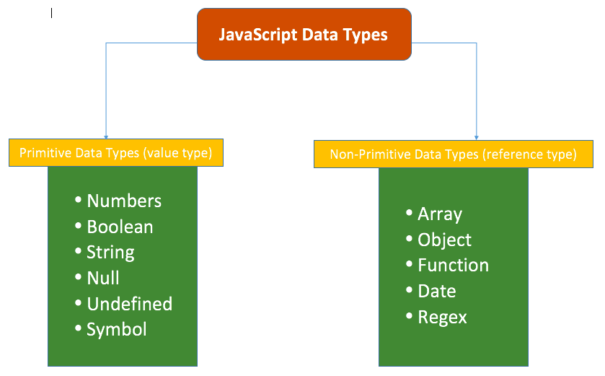
Javascript Datatype
Types of Datatype
Primitive Data Types
Non-Primitive Data Types
Image Source: https://miro.medium.com/max/839/1*EJVSM8Mtm6kPmPYMTP5gug.png
Notes:
Left (White Color space):
Title - Parent Topic
Subtitle - Subtopic 1
Body Text - Description in bullets
Right (Grey Color Space):
Body Text - Relevant image (with source)/code snippet
Put reference links in Speaker Notes
Reference:
https://www.tutorialspoint.com/internet_technologies/internet_overview.htm/

Slide 15
Types of Datatype
Data Type | Description
String | String is a textual content wrapped inside ' ' or " " or ` ` (tick sign). Example: 'Hello World!', "This is a string", etc.
Number | Number is a numeric value. Example: 100, 4521983, etc.
BigInt | BigInt is a numeric value in the arbitrary precision format. Example: 453889879865131n, 200n, etc.
Boolean | Boolean is a logical data type that has only two values, true or false.
Null | A null value denotes an absence of value. Example: var str = null;
Undefined | undefined is the default value of a variable that has not been assigned any value. Example: In the variable declaration, var str;, there is no value assigned to str. So, the type of str can be check using typeof(str) which will return undefined.
Primitive Datatypes
The primitive data types are the lowest level of the data value in JavaScript. The typeof operator can be used with primitive data types to know the type of a value.
Notes:
Left (White Color space):
Title - Parent Topic
Subtitle - Subtopic 1
Body Text - Description in bullets
Right (Grey Color Space):
Body Text - Relevant image (with source)/code snippet
Put reference links in Speaker Notes
Reference:
https://www.tutorialspoint.com/internet_technologies/internet_overview.htm/

Slide 16
Types of Datatype
Data Type | Description
Object | An object holds multiple values in terms of properties and methods. Example: var person = { firstName: "James", lastName: "Bond", age: 15 };
Date | Date object represents date & time including days, months, years, hours, minutes, seconds and milliseconds. Example: var today = new Date("25 July 2021");
Array | An array stores multiple values using special syntax. Example: var nums = [1, 2, 3, 4];
Non-Primitive Datatypes
The non-primitive data types contain some kind of structure with primitive data.
Notes:
Left (White Color space):
Title - Parent Topic
Subtitle - Subtopic 1
Body Text - Description in bullets
Right (Grey Color Space):
Body Text - Relevant image (with source)/code snippet
Put reference links in Speaker Notes
Reference:
https://www.tutorialspoint.com/internet_technologies/internet_overview.htm/

Slide 17
Types of Datatype
Data Type | Description
Object | An object holds multiple values in terms of properties and methods. Example: var person = { firstName: "James", lastName: "Bond", age: 15 };
Date | Date object represents date & time including days, months, years, hours, minutes, seconds and milliseconds. Example: var today = new Date("25 July 2021");
Array | An array stores multiple values using special syntax. Example: var nums = [1, 2, 3, 4];
Non-Primitive Datatypes
The non-primitive data types contain some kind of structure with primitive data.
Notes:
Left (White Color space):
Title - Parent Topic
Subtitle - Subtopic 1
Body Text - Description in bullets
Right (Grey Color Space):
Body Text - Relevant image (with source)/code snippet
Put reference links in Speaker Notes
Reference:
https://www.tutorialspoint.com/internet_technologies/internet_overview.htm/

Slide 18
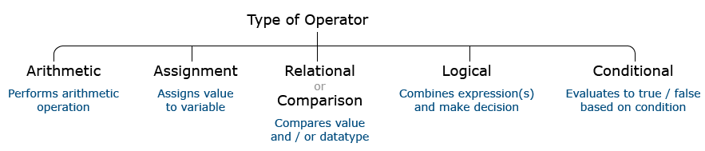
Javascript Operators
What is JavaScript Operator
An operator performs some operation on single or multiple operands (data value) and produces a result.
Syntax:
<Left operand> operator <right operand>
<Left operand> operator
Image Source: https://www.bookofnetwork.com/images/javascript-images/JS_Type-of-Operators_17Sep16_1822.png
Notes:
Left (White Color space):
Title - Parent Topic
Subtitle - Subtopic 1
Body Text - Description in bullets
Right (Grey Color Space):
Body Text - Relevant image (with source)/code snippet
Put reference links in Speaker Notes
Reference:
https://www.tutorialspoint.com/internet_technologies/internet_overview.htm/

Slide 19
Types of Javascript Operators
Operator | Description | Example
+ | Addition | 10+20 = 30
- | Subtraction | 20-10 = 10
* | Multiplication | 10*20 = 200
/ | Division | 20/10 = 2
% | Modulus (Remainder) | 20%10 = 0
++ | Increment | var a=10; a++; Now a = 11
-- | Decrement | var a=10; a--; Now a = 9
Arithmetic Operators
Arithmetic operators are used to perform arithmetic operations on the operands.
Image Source: https://www.bookofnetwork.com/images/javascript-images/JS_Type-of-Operators_17Sep16_1822.png
Notes:
Left (White Color space):
Title - Parent Topic
Subtitle - Subtopic 1
Body Text - Description in bullets
Right (Grey Color Space):
Body Text - Relevant image (with source)/code snippet
Put reference links in Speaker Notes
Reference:
https://www.tutorialspoint.com/internet_technologies/internet_overview.htm/

Slide 20
Types of Javascript Operators
Operator | Description | Example
== | Is equal to | 10==20 = false
=== | Identical (equal and of same type) | 10==20 = false
!= | Not equal to | 10!=20 = true
!== | Not Identical | 20!==20 = false
> | Greater than | 20>10 = true
>= | Greater than or equal to | 20>=10 = true
< | Less than | 20<10 = false
<= | Less than or equal to | 20<=10 = false
Comparison Operators
The JavaScript comparison operator compares the two operands.
Notes:
Left (White Color space):
Title - Parent Topic
Subtitle - Subtopic 1
Body Text - Description in bullets
Right (Grey Color Space):
Body Text - Relevant image (with source)/code snippet
Put reference links in Speaker Notes
Reference:
https://www.tutorialspoint.com/internet_technologies/internet_overview.htm/

Slide 21
Types of Javascript Operators
Operator | Description | Example
& | Bitwise AND | (10==20 & 20==33) = false
| | Bitwise OR | (10==20 | 20==33) = false
^ | Bitwise XOR | (10==20 ^ 20==33) = false
~ | Bitwise NOT | (~10) = -10
<< | Bitwise Left Shift | (10<<2) = 40
>> | Bitwise Right Shift | (10>>2) = 2
>>> | Bitwise Right Shift with Zero | (10>>>2) = 2
Bitwise Operators
The bitwise operators perform bitwise operations on operands.
Notes:
Left (White Color space):
Title - Parent Topic
Subtitle - Subtopic 1
Body Text - Description in bullets
Right (Grey Color Space):
Body Text - Relevant image (with source)/code snippet
Put reference links in Speaker Notes
Reference:
https://www.tutorialspoint.com/internet_technologies/internet_overview.htm/

Slide 22
Types of Javascript Operators
Logical Operators
Operator | Description | Example
&& | Logical AND | (10==20 && 20==33) = false
|| | Logical OR | (10==20 || 20==33) = false
! | Logical Not | !(10==20) = true
The following operators are known as JavaScript logical operators.
Notes:
Left (White Color space):
Title - Parent Topic
Subtitle - Subtopic 1
Body Text - Description in bullets
Right (Grey Color Space):
Body Text - Relevant image (with source)/code snippet
Put reference links in Speaker Notes
Reference:
https://www.tutorialspoint.com/internet_technologies/internet_overview.htm/

Slide 23
Types of Javascript Operators
Assignment Operators
Operator | Description | Example
= | Assign | 10+10 = 20
+= | Add and assign | var a=10; a+=20; Now a = 30
-= | Subtract and assign | var a=20; a-=10; Now a = 10
*= | Multiply and assign | var a=10; a*=20; Now a = 200
/= | Divide and assign | var a=10; a/=2; Now a = 5
%= | Modulus and assign | var a=10; a%=2; Now a = 0
The following operators are known as JavaScript assignment operators.
Notes:
Left (White Color space):
Title - Parent Topic
Subtitle - Subtopic 1
Body Text - Description in bullets
Right (Grey Color Space):
Body Text - Relevant image (with source)/code snippet
Put reference links in Speaker Notes
Reference:
https://www.tutorialspoint.com/internet_technologies/internet_overview.htm/

Slide 24
Types of Javascript Operators
Operator | Description
(?:) | Conditional Operator returns value based on the condition. It is like if-else.
, | Comma Operator allows multiple expressions to be evaluated as single statement.
delete | Delete Operator deletes a property from the object.
in | In Operator checks if object has the given property
instanceof | checks if the object is an instance of given type
new | creates an instance (object)
typeof | checks the type of object.
void | it discards the expression's return value.
yield | checks what is returned in a generator by the generator's iterator.
Special Operators
The following operators are known as JavaScript special operators.
Notes:
Left (White Color space):
Title - Parent Topic
Subtitle - Subtopic 1
Body Text - Description in bullets
Right (Grey Color Space):
Body Text - Relevant image (with source)/code snippet
Put reference links in Speaker Notes
Reference:
https://www.tutorialspoint.com/internet_technologies/internet_overview.htm/

Slide 25
Javascript Condition
Operator | Description
(?:) | Conditional Operator returns value based on the condition. It is like if-else.
, | Comma Operator allows multiple expressions to be evaluated as single statement.
delete | Delete Operator deletes a property from the object.
in | In Operator checks if object has the given property
instanceof | checks if the object is an instance of given type
new | creates an instance (object)
typeof | checks the type of object.
void | it discards the expression's return value.
yield | checks what is returned in a generator by the generator's iterator.
JavaScript If-else
The JavaScript if-else statement is used to execute the code whether condition is true or false. There are three forms of if statement in JavaScript.
If Statement
If else statement
if else if statement
Notes:
Left (White Color space):
Title - Parent Topic
Subtitle - Subtopic 1
Body Text - Description in bullets
Right (Grey Color Space):
Body Text - Relevant image (with source)/code snippet
Put reference links in Speaker Notes
Reference:
https://www.tutorialspoint.com/internet_technologies/internet_overview.htm/

Slide 26
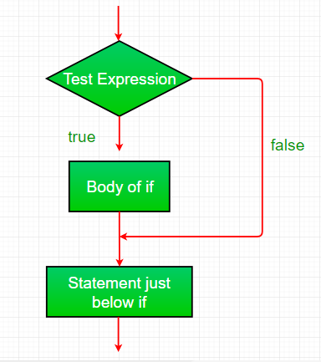
JavaScript If-else
If statement
It evaluates the content only if expression is true.
Syntax:
if(expression)
{
//content to be evaluated
}
Image Source: https://media.geeksforgeeks.org/wp-content/uploads/if.png
Notes:
Left (White Color space):
Title - Parent Topic
Subtitle - Subtopic 1
Body Text - Description in bullets
Right (Grey Color Space):
Body Text - Relevant image (with source)/code snippet
Put reference links in Speaker Notes
Reference:
https://www.tutorialspoint.com/internet_technologies/internet_overview.htm/

Slide 27
JavaScript If-else
If statement
<script>
var a=20;
if(a>10){
document.write("value of a is greater than 10");
}
</script>
Output :
value of a is greater than 10
Image Source: https://media.geeksforgeeks.org/wp-content/uploads/if.png
Notes:
Left (White Color space):
Title - Parent Topic
Subtitle - Subtopic 1
Body Text - Description in bullets
Right (Grey Color Space):
Body Text - Relevant image (with source)/code snippet
Put reference links in Speaker Notes
Reference:
https://www.tutorialspoint.com/internet_technologies/internet_overview.htm/

Slide 28
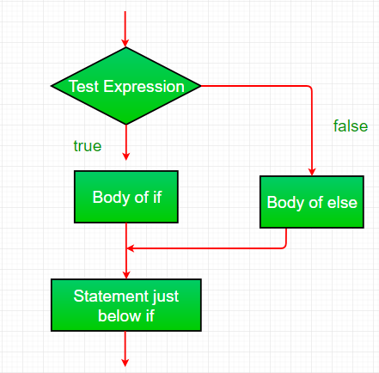
JavaScript If-else
If...else Statement
It evaluates the content whether condition is true of false.
Syntax
if(expression){
//content to be evaluated if condition is true
}
else{
//content to be evaluated if condition is false
}
Image Source: https://media.geeksforgeeks.org/wp-content/uploads/if-else.png
Notes:
Left (White Color space):
Title - Parent Topic
Subtitle - Subtopic 1
Body Text - Description in bullets
Right (Grey Color Space):
Body Text - Relevant image (with source)/code snippet
Put reference links in Speaker Notes
Reference:
https://www.tutorialspoint.com/internet_technologies/internet_overview.htm/

Slide 29
JavaScript If-else
If...else Statement
<script>
var a=20;
if(a%2==0){
document.write("a is even number"); }
else{
document.write("a is odd number"); }
</script>
Output :
a is even number
Image Source: https://media.geeksforgeeks.org/wp-content/uploads/if-else.png
Notes:
Left (White Color space):
Title - Parent Topic
Subtitle - Subtopic 1
Body Text - Description in bullets
Right (Grey Color Space):
Body Text - Relevant image (with source)/code snippet
Put reference links in Speaker Notes
Reference:
https://www.tutorialspoint.com/internet_technologies/internet_overview.htm/

Slide 30
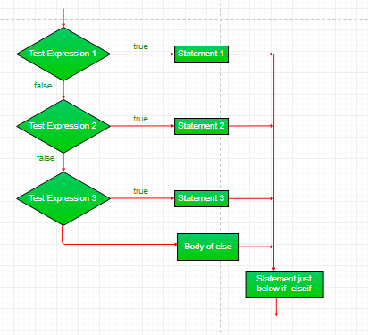
JavaScript If-else
If...else if statement
It evaluates the content only if expression is true from several expressions.
Image Source: https://media.geeksforgeeks.org/wp-content/uploads/if-elseif.png
Notes:
Left (White Color space):
Title - Parent Topic
Subtitle - Subtopic 1
Body Text - Description in bullets
Right (Grey Color Space):
Body Text - Relevant image (with source)/code snippet
Put reference links in Speaker Notes
Reference:
https://www.tutorialspoint.com/internet_technologies/internet_overview.htm/

Slide 31
JavaScript If-else
If...else if statement
if(expression1){
//content to be evaluated if expression1 is true }
else if(expression2)
{ //content to be evaluated if expression2 is true }
else if(expression3)
{ //content to be evaluated if expression3 is true }
else{ //content to be evaluated if no expression is true }
Image Source: https://media.geeksforgeeks.org/wp-content/uploads/if-elseif.png
Notes:
Left (White Color space):
Title - Parent Topic
Subtitle - Subtopic 1
Body Text - Description in bullets
Right (Grey Color Space):
Body Text - Relevant image (with source)/code snippet
Put reference links in Speaker Notes
Reference:
https://www.tutorialspoint.com/internet_technologies/internet_overview.htm/

Slide 32
JavaScript If-else
If...else if statement
<script>
var a=20;
if(a==10){
document.write("a is equal to 10");
}
else if(a==15){
document.write("a is equal to 15");
}
Image Source: https://media.geeksforgeeks.org/wp-content/uploads/if-elseif.png
Notes:
Left (White Color space):
Title - Parent Topic
Subtitle - Subtopic 1
Body Text - Description in bullets
Right (Grey Color Space):
Body Text - Relevant image (with source)/code snippet
Put reference links in Speaker Notes
Reference:
https://www.tutorialspoint.com/internet_technologies/internet_overview.htm/

Slide 33
JavaScript If-else
If...else if statement
else if(a==20){
document.write("a is equal to 20");
}
else{
document.write("a is not equal to 10, 15 or 20");
}
</script>
Output of the above example
a is equal to 20
Image Source: https://media.geeksforgeeks.org/wp-content/uploads/if-elseif.png
Notes:
Left (White Color space):
Title - Parent Topic
Subtitle - Subtopic 1
Body Text - Description in bullets
Right (Grey Color Space):
Body Text - Relevant image (with source)/code snippet
Put reference links in Speaker Notes
Reference:
https://www.tutorialspoint.com/internet_technologies/internet_overview.htm/

Slide 34
JavaScript If-else
If...else if statement
else if(a==20){
document.write("a is equal to 20");
}
else{
document.write("a is not equal to 10, 15 or 20");
}
</script>
Output :
a is equal to 20
Image Source: https://media.geeksforgeeks.org/wp-content/uploads/if-elseif.png
Notes:
Left (White Color space):
Title - Parent Topic
Subtitle - Subtopic 1
Body Text - Description in bullets
Right (Grey Color Space):
Body Text - Relevant image (with source)/code snippet
Put reference links in Speaker Notes
Reference:
https://www.tutorialspoint.com/internet_technologies/internet_overview.htm/

Slide 35
Javascript Condition
JavaScript Switch
The JavaScript switch statement is used to execute one code from multiple expressions.
It is just like else if statement that we have learned in previous page. But it is convenient than if..else..if because it can be used with numbers, characters etc.
Image Source: https://media.geeksforgeeks.org/wp-content/uploads/switch.png
Notes:
Left (White Color space):
Title - Parent Topic
Subtitle - Subtopic 1
Body Text - Description in bullets
Right (Grey Color Space):
Body Text - Relevant image (with source)/code snippet
Put reference links in Speaker Notes
Reference:
https://www.tutorialspoint.com/internet_technologies/internet_overview.htm/

Slide 36
Javascript Condition
JavaScript Switch
Syntax:
switch(expression){
case value1:
code to be executed;
break;
case value2:
code to be executed;
break;
......
default:
Image Source: https://media.geeksforgeeks.org/wp-content/uploads/switch.png
Notes:
Left (White Color space):
Title - Parent Topic
Subtitle - Subtopic 1
Body Text - Description in bullets
Right (Grey Color Space):
Body Text - Relevant image (with source)/code snippet
Put reference links in Speaker Notes
Reference:
https://www.tutorialspoint.com/internet_technologies/internet_overview.htm/

Slide 37
Javascript Condition
JavaScript Switch
Syntax:
switch(expression){
case value1:
code to be executed;
break;
case value2:
code to be executed;
break;
......
default:
Image Source: https://media.geeksforgeeks.org/wp-content/uploads/switch.png
Notes:
Left (White Color space):
Title - Parent Topic
Subtitle - Subtopic 1
Body Text - Description in bullets
Right (Grey Color Space):
Body Text - Relevant image (with source)/code snippet
Put reference links in Speaker Notes
Reference:
https://www.tutorialspoint.com/internet_technologies/internet_overview.htm/

Slide 38
Javascript Condition
JavaScript Switch
Example:
<script>
var grade='B';
var result;
switch(grade){
case 'A':
result+=" A Grade";
case 'B':
result+=" B Grade";
case 'C':
Image Source: https://media.geeksforgeeks.org/wp-content/uploads/switch.png
Notes:
Left (White Color space):
Title - Parent Topic
Subtitle - Subtopic 1
Body Text - Description in bullets
Right (Grey Color Space):
Body Text - Relevant image (with source)/code snippet
Put reference links in Speaker Notes
Reference:
https://www.tutorialspoint.com/internet_technologies/internet_overview.htm/

Slide 39
Javascript Condition
JavaScript Switch
result+=" C Grade";
default:
result+=" No Grade";
}
document.write(result);
</script>
Output:
undefined B Grade C Grade No Grade
Image Source: https://media.geeksforgeeks.org/wp-content/uploads/switch.png
Notes:
Left (White Color space):
Title - Parent Topic
Subtitle - Subtopic 1
Body Text - Description in bullets
Right (Grey Color Space):
Body Text - Relevant image (with source)/code snippet
Put reference links in Speaker Notes
Reference:
https://www.tutorialspoint.com/internet_technologies/internet_overview.htm/

Slide 40
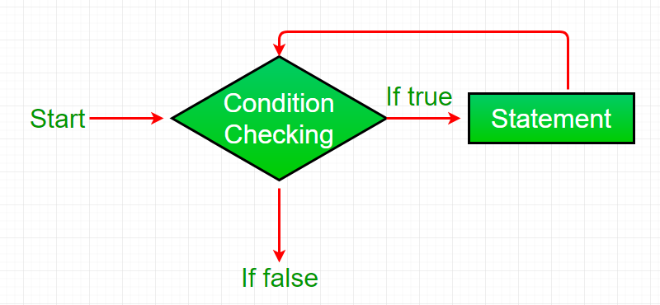
Loop Control statement
JavaScript Types of Loop
The JavaScript loops are used to iterate the piece of code using for, while, do while or for-in loops.
There are four types of loops in JavaScript.
for loop
while loop
do-while loop
for-in loop
Image Source: https://media.geeksforgeeks.org/wp-content/uploads/Loop1.png
Notes:
Left (White Color space):
Title - Parent Topic
Subtitle - Subtopic 1
Body Text - Description in bullets
Right (Grey Color Space):
Body Text - Relevant image (with source)/code snippet
Put reference links in Speaker Notes
Reference:
https://www.tutorialspoint.com/internet_technologies/internet_overview.htm/

Slide 41
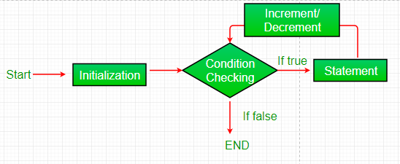
Loop Control statement
For loop
The JavaScript for loop iterates the elements for the fixed number of times. It should be used if number of iterations is known.
Syntax:
for (initialization; condition; increment)
{
code to be executed
}
Image Source: https://media.geeksforgeeks.org/wp-content/uploads/loop2.png
Notes:
Left (White Color space):
Title - Parent Topic
Subtitle - Subtopic 1
Body Text - Description in bullets
Right (Grey Color Space):
Body Text - Relevant image (with source)/code snippet
Put reference links in Speaker Notes
Reference:
https://www.tutorialspoint.com/internet_technologies/internet_overview.htm/

Slide 42
Loop Control statement
While loop
The JavaScript while loop iterates the elements for the infinite number of times. It should be used if number of iteration is not known.
Syntax:
while (condition)
{
code to be executed
}
Image Source: https://media.geeksforgeeks.org/wp-content/uploads/Loop1.png
Notes:
Left (White Color space):
Title - Parent Topic
Subtitle - Subtopic 1
Body Text - Description in bullets
Right (Grey Color Space):
Body Text - Relevant image (with source)/code snippet
Put reference links in Speaker Notes
Reference:
https://www.tutorialspoint.com/internet_technologies/internet_overview.htm/

Slide 43
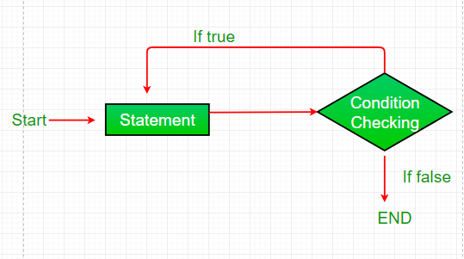
Loop Control statement
do while loop
The JavaScript do while loop iterates the elements for the infinite number of times like while loop. but, code is executed at least once whether condition is true or false. Syntax:
do{
code to be executed
}while (condition);
Image Source: https://media.geeksforgeeks.org/wp-content/uploads/loop3.png
Notes:
Left (White Color space):
Title - Parent Topic
Subtitle - Subtopic 1
Body Text - Description in bullets
Right (Grey Color Space):
Body Text - Relevant image (with source)/code snippet
Put reference links in Speaker Notes
Reference:
https://www.tutorialspoint.com/internet_technologies/internet_overview.htm/

Slide 44
Loop Control statement
for-in loop
The for..in loop provides a simpler way to iterate through the properties of an object. Syntax:
for (variableName in Object)
{
statement(s)
}(condition);
Image Source: https://media.geeksforgeeks.org/wp-content/uploads/loop2.png
Notes:
Left (White Color space):
Title - Parent Topic
Subtitle - Subtopic 1
Body Text - Description in bullets
Right (Grey Color Space):
Body Text - Relevant image (with source)/code snippet
Put reference links in Speaker Notes
Reference:
https://www.tutorialspoint.com/internet_technologies/internet_overview.htm/

Slide 45
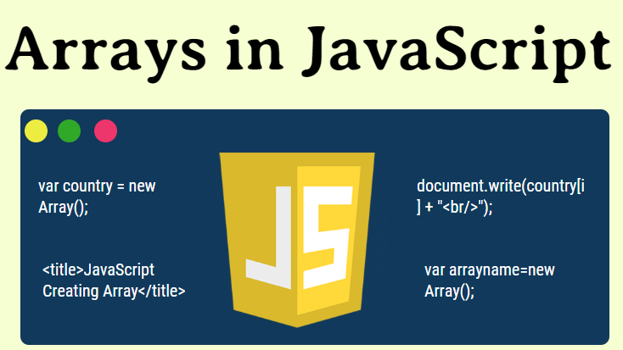
JavaScript Array
What is Arrays
JavaScript array is an object that represents a collection of similar type of elements.
There are 3 ways to construct array in JavaScript
i. By array literal
ii. By creating instance of Array directly (using new keyword)
iii. By using an Array constructor (using new keyword)
Image Source: https://cdn.educba.com/academy/wp-content/uploads/2019/09/Arrays-in-JavaScript.png
Notes:
Left (White Color space):
Title - Parent Topic
Subtitle - Subtopic 1
Body Text - Description in bullets
Right (Grey Color Space):
Body Text - Relevant image (with source)/code snippet
Put reference links in Speaker Notes
Reference:
https://www.tutorialspoint.com/internet_technologies/internet_overview.htm/

Slide 46
JavaScript Array
JavaScript array literal
Syntax:
var arrayname=[value1,value2.....valueN];
Image Source: https://cdn.educba.com/academy/wp-content/uploads/2019/09/Arrays-in-JavaScript.png
Notes:
Left (White Color space):
Title - Parent Topic
Subtitle - Subtopic 1
Body Text - Description in bullets
Right (Grey Color Space):
Body Text - Relevant image (with source)/code snippet
Put reference links in Speaker Notes
Reference:
https://www.tutorialspoint.com/internet_technologies/internet_overview.htm/

Slide 47
JavaScript Array
JavaScript Array directly
Syntax:
var arrayname=new Array();
Image Source: https://cdn.educba.com/academy/wp-content/uploads/2019/09/Arrays-in-JavaScript.png
Notes:
Left (White Color space):
Title - Parent Topic
Subtitle - Subtopic 1
Body Text - Description in bullets
Right (Grey Color Space):
Body Text - Relevant image (with source)/code snippet
Put reference links in Speaker Notes
Reference:
https://www.tutorialspoint.com/internet_technologies/internet_overview.htm/

Slide 48
JavaScript Array
JavaScript array constructor
Here, you need to create instance of array by passing arguments in constructor so that we don't have to provide value explicitly.
Example:
<script>
var emp=new Array("Jai","Vijay","Smith");
for (i=0;i<emp.length;i++){
document.write(emp[i] + "<br>");
}
</script>
Image Source: https://cdn.educba.com/academy/wp-content/uploads/2019/09/Arrays-in-JavaScript.png
Notes:
Left (White Color space):
Title - Parent Topic
Subtitle - Subtopic 1
Body Text - Description in bullets
Right (Grey Color Space):
Body Text - Relevant image (with source)/code snippet
Put reference links in Speaker Notes
Reference:
https://www.tutorialspoint.com/internet_technologies/internet_overview.htm/

Slide 49
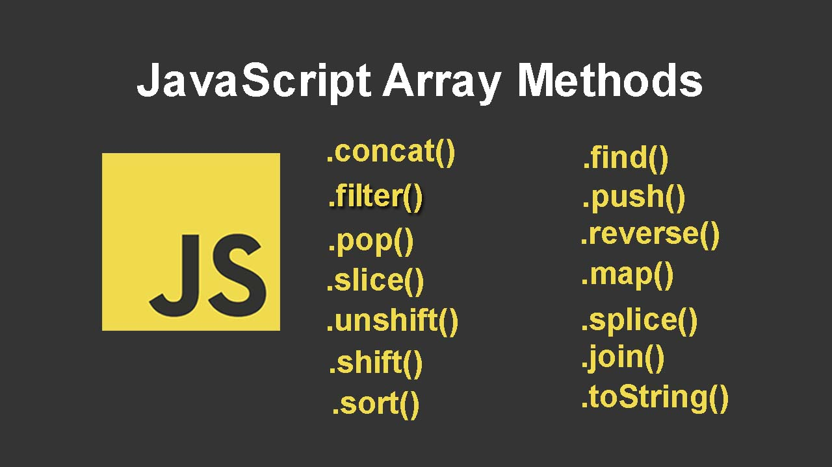
JavaScript Array
JavaScript Array Methods
Let's see the list of JavaScript array methods.
Image Source: https://i.imgur.com/ZJT26qb.jpg
Notes:
Left (White Color space):
Title - Parent Topic
Subtitle - Subtopic 1
Body Text - Description in bullets
Right (Grey Color Space):
Body Text - Relevant image (with source)/code snippet
Put reference links in Speaker Notes
Reference:
https://www.tutorialspoint.com/internet_technologies/internet_overview.htm/

Slide 50
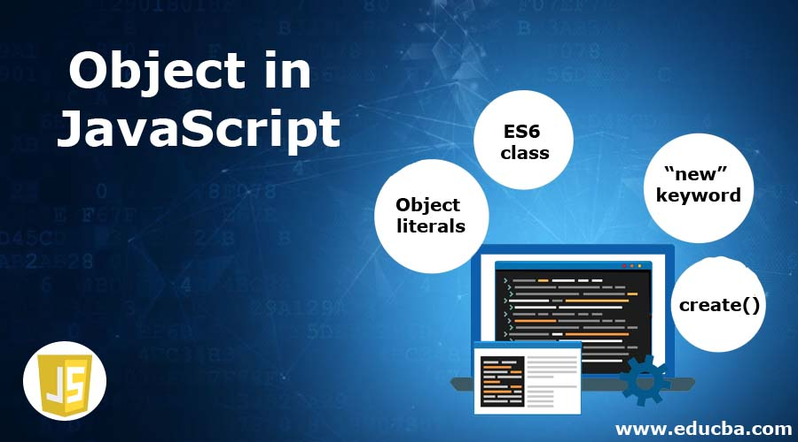
Javascript Object
What is Javascript Object
A javaScript object is an entity having state and behavior. For example: car, pen, bike, chair, glass, keyboard, monitor etc.
JavaScript is an object-based language. Everything is an object in JavaScript.
JavaScript is template based not class based.
Image Source: https://cdn.educba.com/academy/wp-content/uploads/2020/05/Object-in-JavaScript.jpg
Notes:
Left (White Color space):
Title - Parent Topic
Subtitle - Subtopic 1
Body Text - Description in bullets
Right (Grey Color Space):
Body Text - Relevant image (with source)/code snippet
Put reference links in Speaker Notes
Reference:
https://www.tutorialspoint.com/internet_technologies/internet_overview.htm/

Slide 51
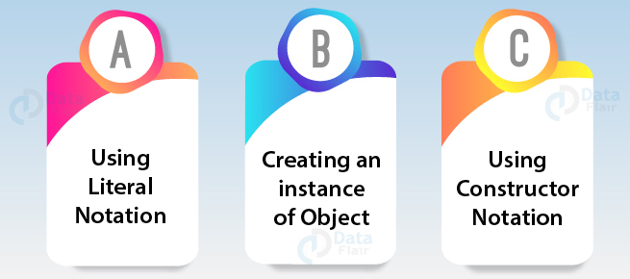
Javascript Object
Creating Objects in JavaScript
There are 3 ways to create objects.
By object literal
By creating instance of Object directly
By using an object constructor
Image Source: https://data-flair.training/blogs/wp-content/uploads/sites/2/2019/07/How-to-Create-JavaScript-Objects.jpg
Notes:
Left (White Color space):
Title - Parent Topic
Subtitle - Subtopic 1
Body Text - Description in bullets
Right (Grey Color Space):
Body Text - Relevant image (with source)/code snippet
Put reference links in Speaker Notes
Reference:
https://www.tutorialspoint.com/internet_technologies/internet_overview.htm/

Slide 52
Javascript Object
Defining method in JavaScript Object
We can define method in JavaScript object. But before defining method, we need to add property in the function with same name as method.
Image Source: https://cdn.educba.com/academy/wp-content/uploads/2020/05/Object-in-JavaScript.jpg
Notes:
Left (White Color space):
Title - Parent Topic
Subtitle - Subtopic 1
Body Text - Description in bullets
Right (Grey Color Space):
Body Text - Relevant image (with source)/code snippet
Put reference links in Speaker Notes
Reference:
https://www.tutorialspoint.com/internet_technologies/internet_overview.htm/

Slide 53
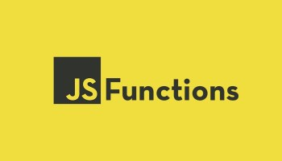
JavaScript Function
What is Javascript Function
A function is a block of code that performs a specific task.
Suppose you need to create a program to create a circle and color it. You can create two functions to solve this problem:
a function to draw the circle
a function to color the circle
Image Source: https://i0.wp.com/blog.alexdevero.com/wp-content/uploads/2020/01/javascript-functions-all-you-need-to-know-pt.1.jpg?fit=1024%2C635&ssl=1&resize=350%2C200
Notes:
Left (White Color space):
Title - Parent Topic
Subtitle - Subtopic 1
Body Text - Description in bullets
Right (Grey Color Space):
Body Text - Relevant image (with source)/code snippet
Put reference links in Speaker Notes
Reference:
https://www.tutorialspoint.com/internet_technologies/internet_overview.htm/

Slide 54
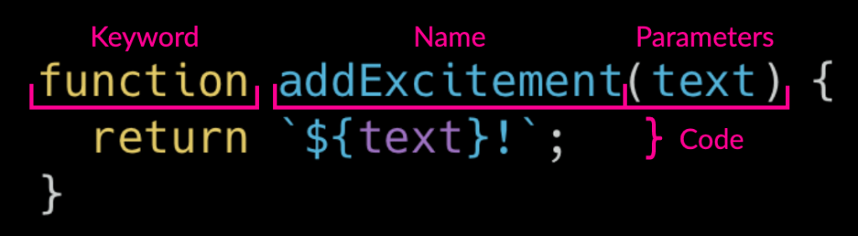
JavaScript Function
Declaring a Function
A function is declared using the function keyword.
The basic rules of naming a function are similar to naming a variable.
The body of function is written within {}.
Syntax:
function nameOfFunction () {
// function body
}
Image Source: https://raddevon.com/wp-content/uploads/2019/07/function-declaration-diagram-1024x282.png
Notes:
Left (White Color space):
Title - Parent Topic
Subtitle - Subtopic 1
Body Text - Description in bullets
Right (Grey Color Space):
Body Text - Relevant image (with source)/code snippet
Put reference links in Speaker Notes
Reference:
https://www.tutorialspoint.com/internet_technologies/internet_overview.htm/

Slide 55
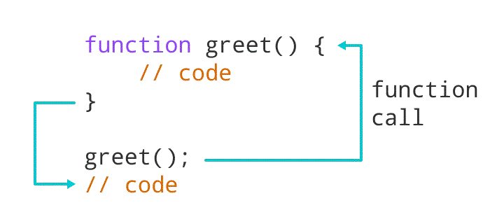
JavaScript Function
Calling a Function
A function is declared using the function keyword.
The basic rules of naming a function are similar to naming a variable.
The body of function is written within {}.
Syntax:
function nameOfFunction () {
// function body
}
Image Source: https://cdn.programiz.com/cdn/farfuture/NdxxeWlRfoHMPgdcWPkeVy1wN9MwAgoqoYqZkFQDMFQ/mtime:1591592059/sites/tutorial2program/files/javascript-function-example1.png
Notes:
Left (White Color space):
Title - Parent Topic
Subtitle - Subtopic 1
Body Text - Description in bullets
Right (Grey Color Space):
Body Text - Relevant image (with source)/code snippet
Put reference links in Speaker Notes
Reference:
https://www.tutorialspoint.com/internet_technologies/internet_overview.htm/

Slide 56
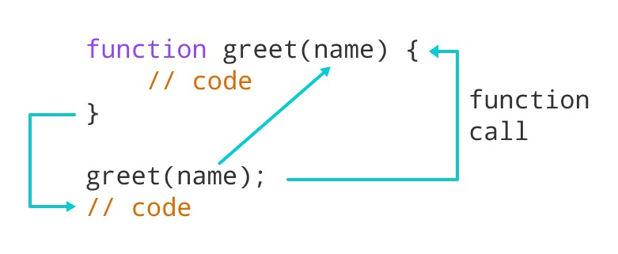
JavaScript Function
Function Parameters
A function can also be declared with parameters. A parameter is a value that is passed when declaring a function
Image Source: https://cdn.programiz.com/cdn/farfuture/oAZVf3IqOKOYj_aJ-IoYQvbJ2CB-B3y4HXSLXBUmYcY/mtime:1591592163/sites/tutorial2program/files/javascript-function-with-parameter.png
Notes:
Left (White Color space):
Title - Parent Topic
Subtitle - Subtopic 1
Body Text - Description in bullets
Right (Grey Color Space):
Body Text - Relevant image (with source)/code snippet
Put reference links in Speaker Notes
Reference:
https://www.tutorialspoint.com/internet_technologies/internet_overview.htm/

Slide 57
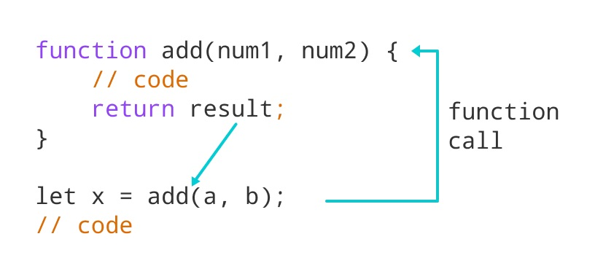
JavaScript Function
Function Return
The return statement can be used to return the value to a function call.
The return statement denotes that the function has ended. Any code after return is not executed.
If nothing is returned, the function returns an undefined value.
Image Source: https://cdn.programiz.com/cdn/farfuture/b4h4Zo5ZYxj-EyfQyao-J5TqbKEefFgqqusPGLWPFS0/mtime:1591786573/sites/tutorial2program/files/javascript-return-statement.png
Notes:
Left (White Color space):
Title - Parent Topic
Subtitle - Subtopic 1
Body Text - Description in bullets
Right (Grey Color Space):
Body Text - Relevant image (with source)/code snippet
Put reference links in Speaker Notes
Reference:
https://www.tutorialspoint.com/internet_technologies/internet_overview.htm/

Slide 58
JavaScript Function
Benefits of Using a Function
Function makes the code reusable. You can declare it once and use it multiple times.
Function makes the program easier as each small task is divided into a function.
Function increases readability.
Image Source: https://i0.wp.com/blog.alexdevero.com/wp-content/uploads/2020/01/javascript-functions-all-you-need-to-know-pt.1.jpg?fit=1024%2C635&ssl=1&resize=350%2C200
Notes:
Left (White Color space):
Title - Parent Topic
Subtitle - Subtopic 1
Body Text - Description in bullets
Right (Grey Color Space):
Body Text - Relevant image (with source)/code snippet
Put reference links in Speaker Notes
Reference:
https://www.tutorialspoint.com/internet_technologies/internet_overview.htm/

Slide 59
JavaScript Function
Function Expressions
In Javascript, functions can also be defined as expressions.
// program to find the square of a number
let x = function (num) { return num * num };
console.log(x(4));
// can be used as variable value for other variables
let y = x(3);
console.log(y);
Output
16
9
Image Source: Source: https://i0.wp.com/blog.alexdevero.com/wp-content/uploads/2020/01/javascript-functions-all-you-need-to-know-pt.1.jpg?fit=1024%2C635&ssl=1&resize=350%2C200
Notes:
Left (White Color space):
Title - Parent Topic
Subtitle - Subtopic 1
Body Text - Description in bullets
Right (Grey Color Space):
Body Text - Relevant image (with source)/code snippet
Put reference links in Speaker Notes
Reference:
https://www.tutorialspoint.com/internet_technologies/internet_overview.htm/

